Slide 1
CUSTOMER SEGMENTATION USING K-MEANS CLUSTERING
by
Dharma Teja Bandaru, Sai Teja Gandla, Michael Torres
New Mexico State University
Computer Science Department

Slide 2
MEANING:
Customer Segmentation is the subdivision of a market into discrete customer groups that share similar characteristics.
Customer Segmentation can be a powerful means to identify unsatisfied customer needs.
Using the data companies can then outperform the competition by developing uniquely appealing products and services.
1

Slide 3
COMMON WAYS:
The most common ways in which businesses segment their customer base are:
Demographic information: such as gender, age, familial and marital status, income, education, and occupation.
Geographical information: which differs depending on the scope of the company. For localized businesses, this info might pertain to specific towns or counties. For larger companies, it might mean a customer’s city, state, or even country of residence.
2

Slide 4
COMMON WAYS (Cont.):
Psychographics: such as social class, lifestyle, and personality traits.
Behavioral data: such as spending and consumption habits, product/service usage, and desired benefits.
3

Slide 5
ADVANTAGES OF CUSTOMER SEGMENTATION:
Determine appropriate product pricing.
Develop customized marketing campaigns.
Design an optimal distribution strategy.
Choose specific product features for deployment.
Prioritize new product development efforts.
4

Slide 6
THE CHALLENGE:
You are owing a supermarket mall and through membership cards, you have some basic data about your customers like Customer ID, age, annual income and spending score.
You want to understand the customers like who are the target customers so that the sense can be given to marketing team and plan the strategy accordingly.
5

Slide 7
K- MEANS CLUSTERING ALGORITHM:
Specify number of clusters K.
Initialize centroids by first shuffling the dataset and then randomly selecting K data points for the centroids without replacement.
Keep iterating until there is no change to the centroids. i.e assignment of data points to clusters isn’t changing.
6

Slide 8
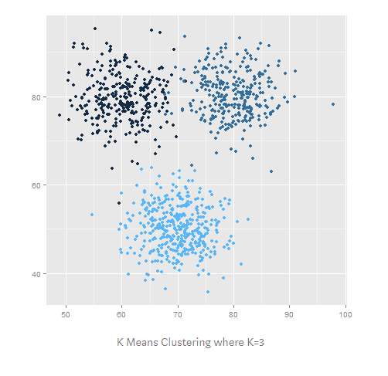
K- MEANS CLUSTERING ALGORITHM(Cont.):
7

Slide 9
DATA:
We have taken data of customers visiting the mall, details about customers annual income and spending expenditures.
We have simulated different graphs which helps us to visualize the data.
The data used in our project is for the Mall Customer Segmentation Data.
The code is used in Python and the software used is PyCharm.
8

Slide 10
ENVIRONMENT AND TOOLS:
scikit-learn
seaborn
numpy
pandas
matplotlib
9

Slide 11
STEPS:
First we loaded all the libraries and dependencies.
Then we arranged the columns in the dataset like customer id, gender, age, income and spending score.
After that we plotted different graphs according to the data.
10

Slide 12
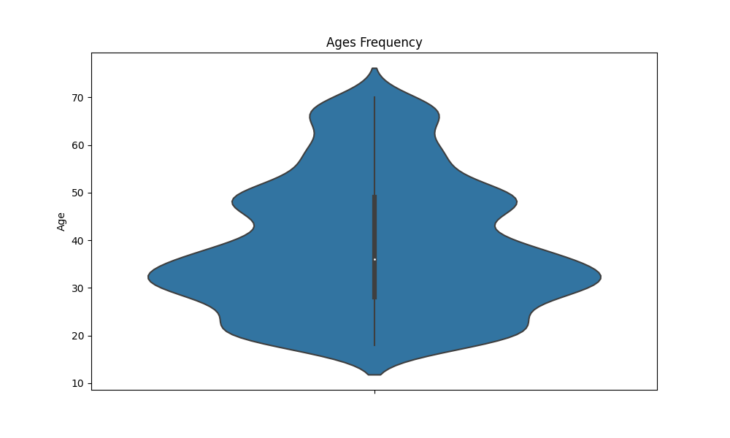
PLOTS:
Age frequency plot of the customers
11

Slide 13
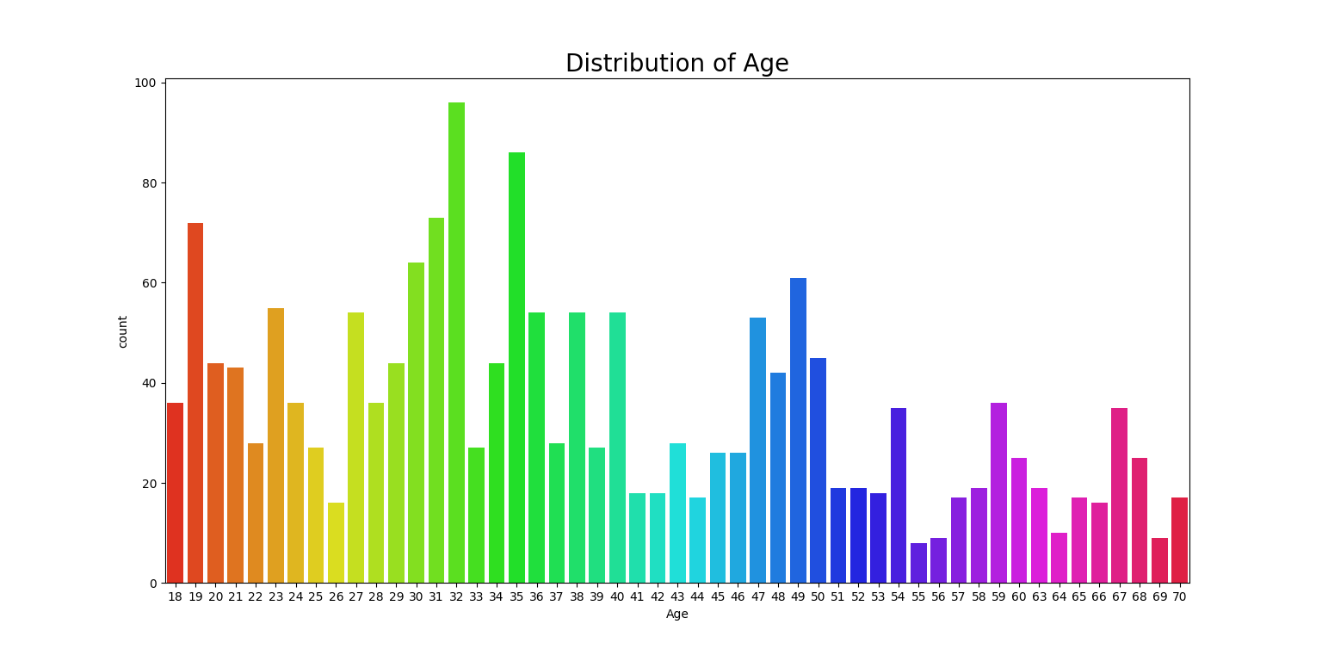
PLOTS (Cont.):
Plot of count and distribution of age
12

Slide 14
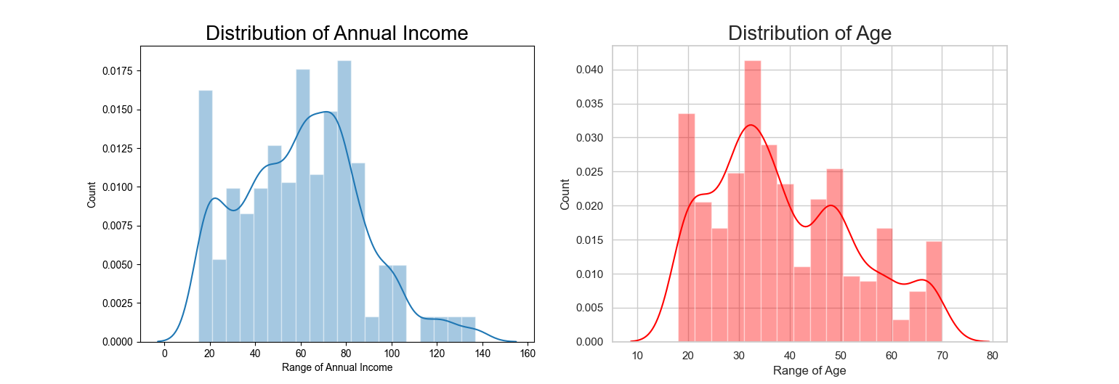
PLOTS (Cont.):
Plot of distribution of annual income and distribution of age
13

Slide 15
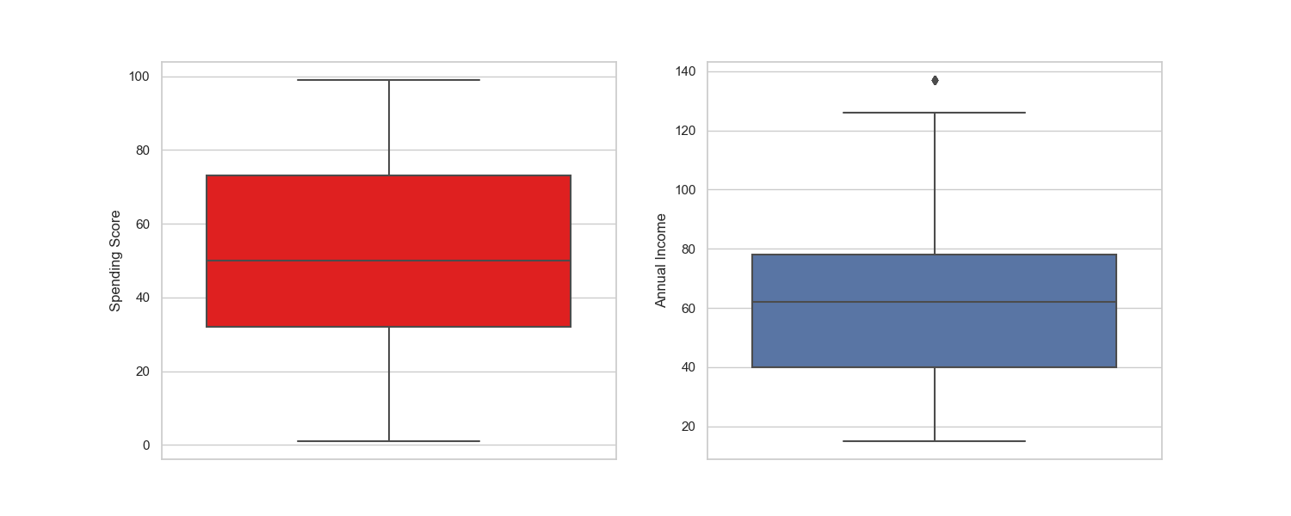
PLOTS (Cont.):
Box plot of spending score and annual income
14

Slide 16
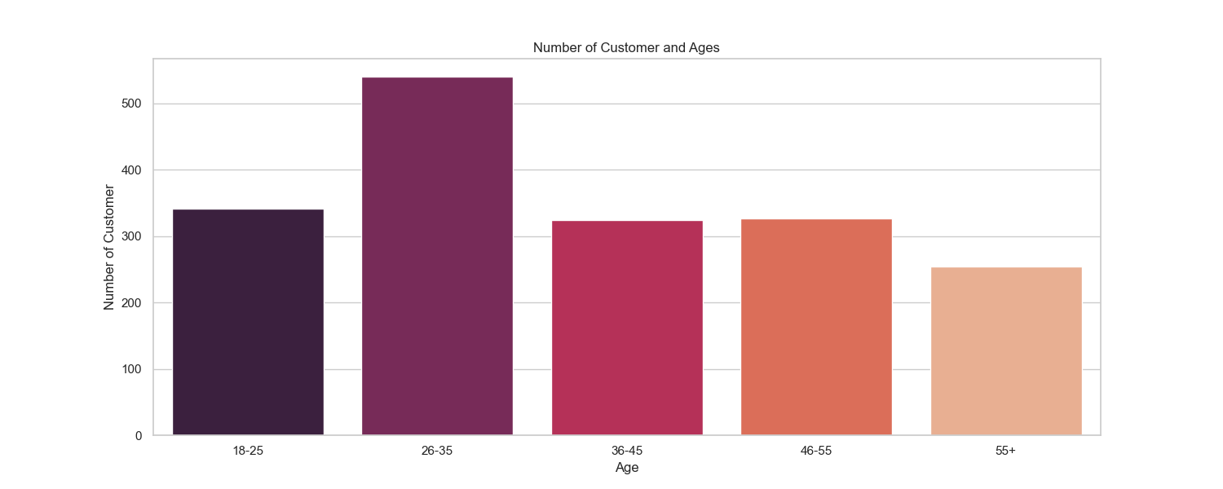
PLOTS (Cont.):
Bar plot to check the distribution of number of customers in each age group
15

Slide 17
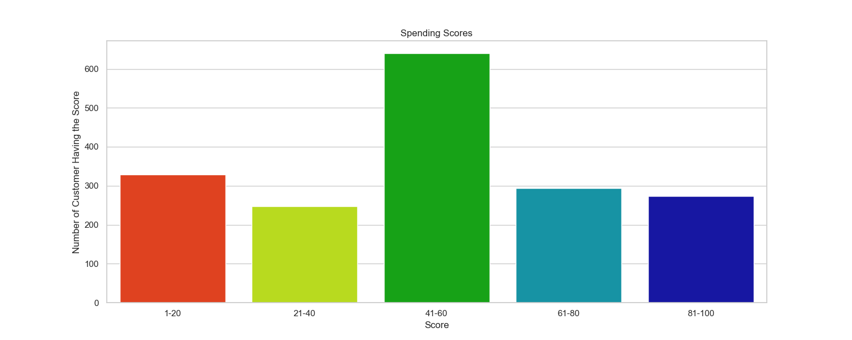
PLOTS (Cont.):
Bar plot to visualize the number of customers according to their spending scores
16

Slide 18
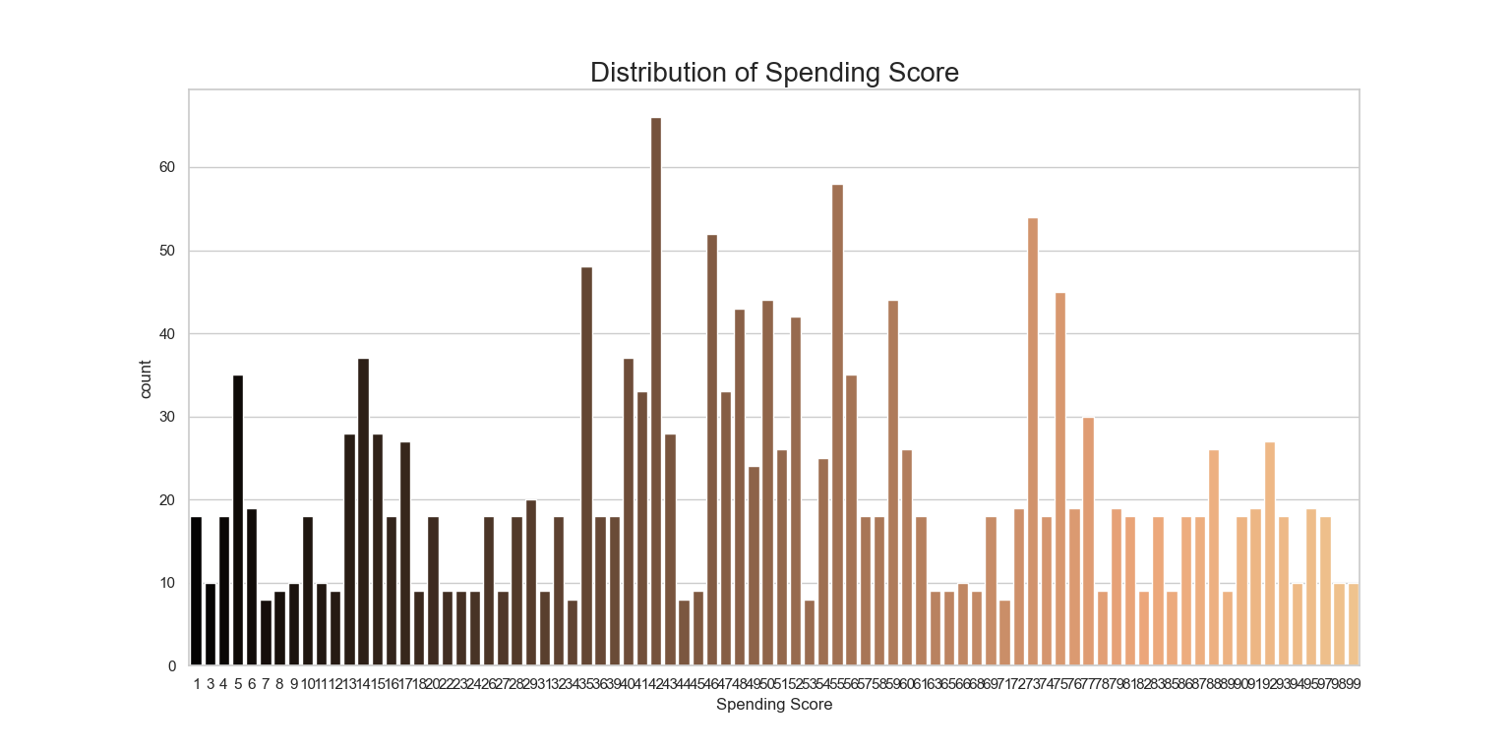
PLOTS (Cont.):
Plot of distribution of spending score
17

Slide 19
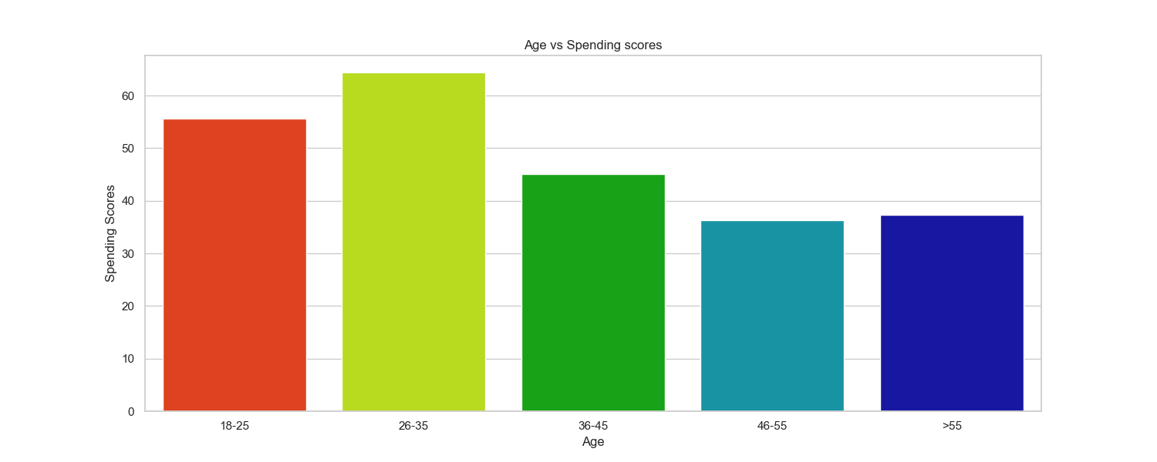
PLOTS (Cont.):
Bar plot of age vs spending scores
18

Slide 20
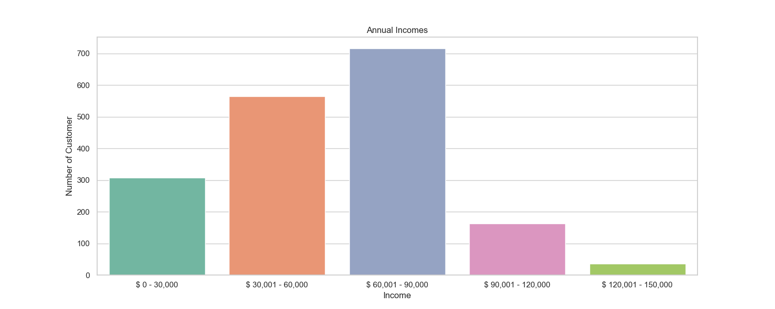
PLOTS (Cont.):
Bar plot to visualize the number of customers according to their annual income
19

Slide 21
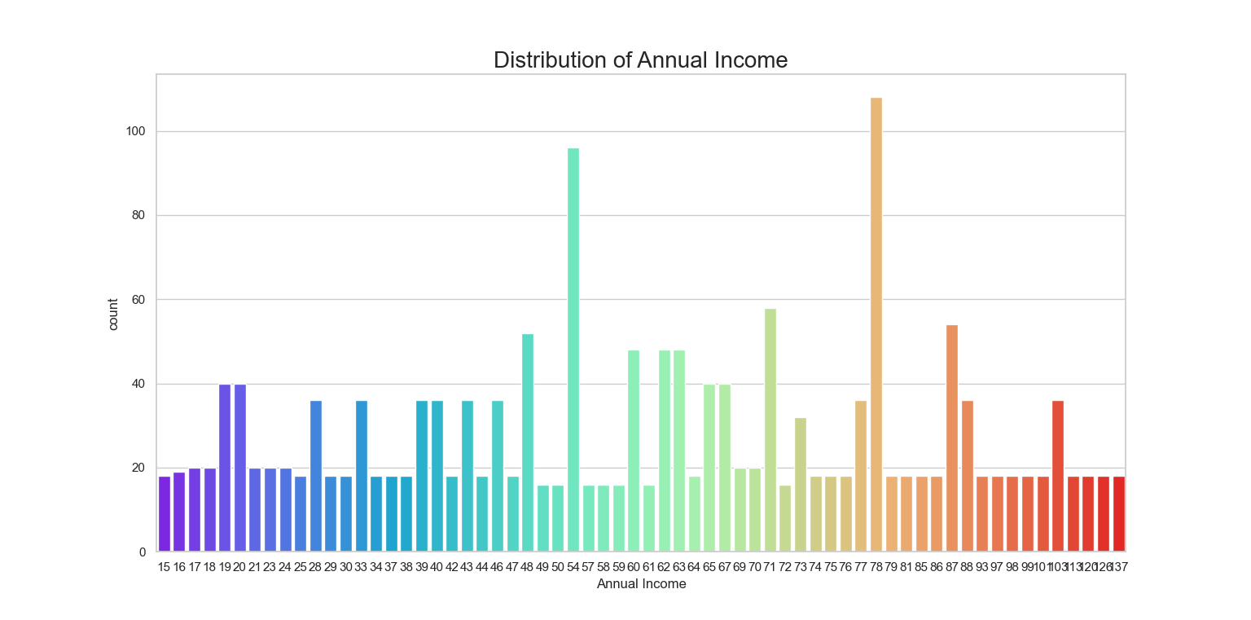
PLOTS (Cont.):
Plot of distribution of annual income
20

Slide 22
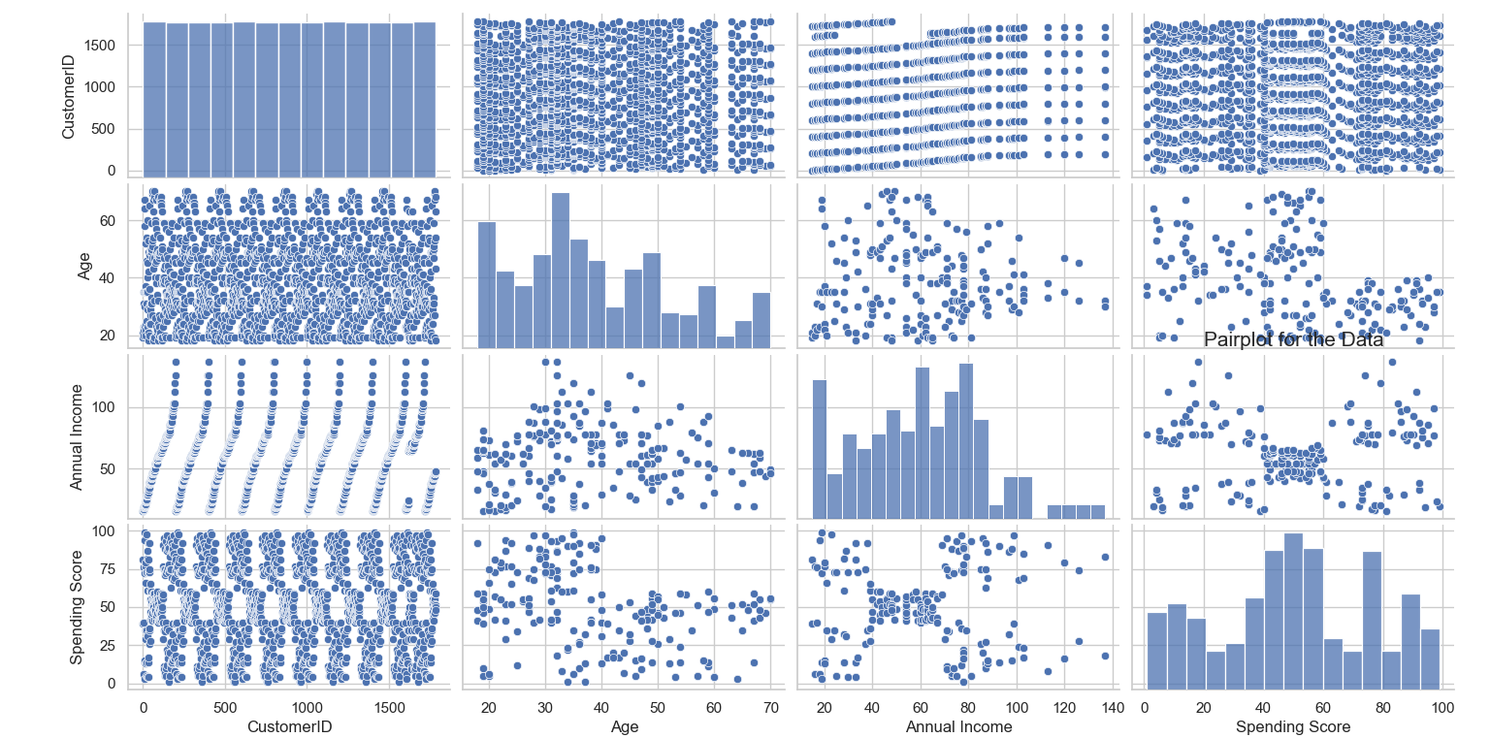
PLOTS (Cont.):
Pair-plot to visualize the relationship between columns
21

Slide 23
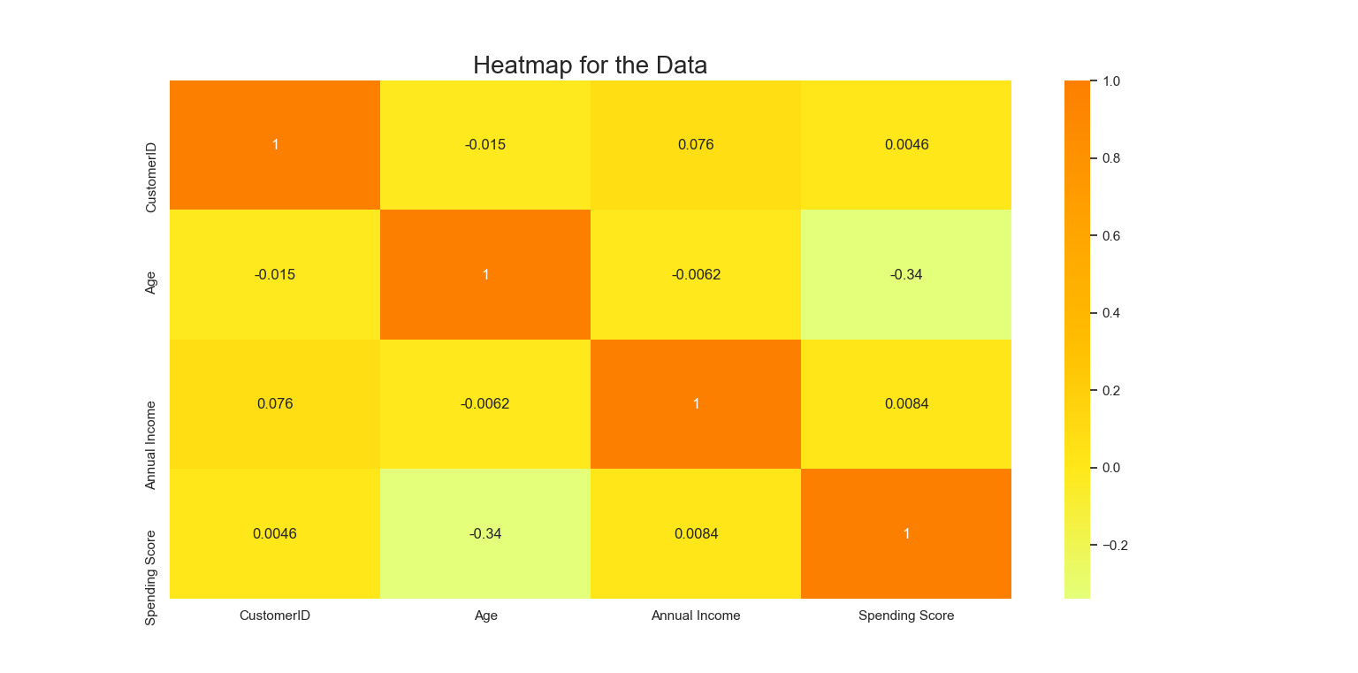
PLOTS (Cont.):
Heatmap plot for the data
22

Slide 24
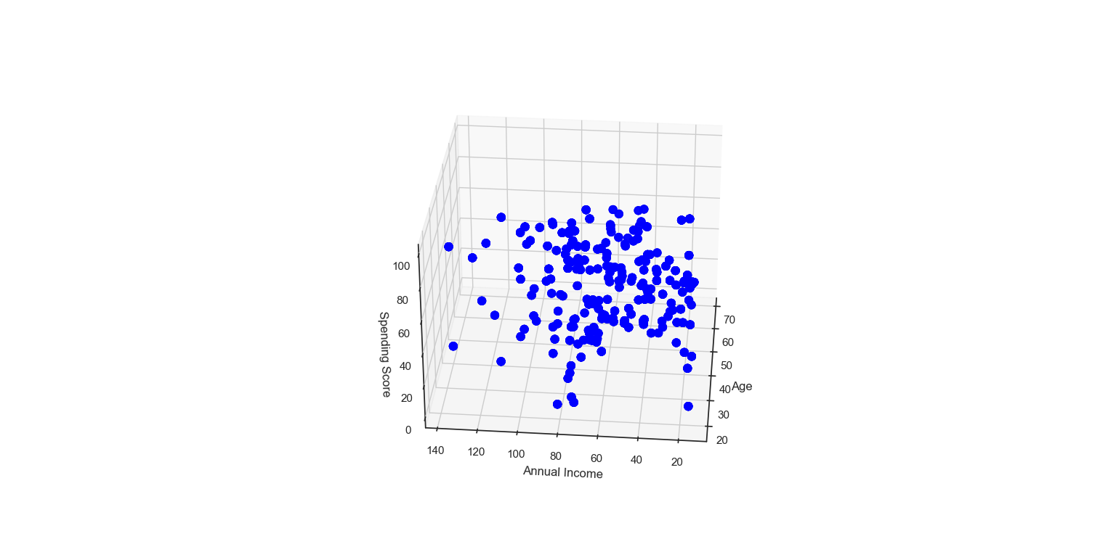
PLOTS (Cont.):
3-D plot of annual income vs spending score vs age
23

Slide 25
THE ELBOW METHOD:
Calculates the Within Cluster Sum of Squared Errors (WSS) for different values of k, and choose the k for which WSS first starts to diminish.
25

Slide 26
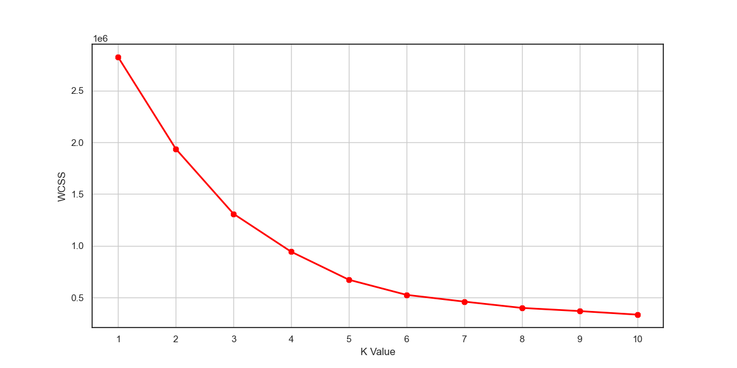
THE ELBOW METHOD (Cont.):
In the plot of WSS-versus k, this is visible as an elbow.
The optimal K value is found to be 5 using the elbow method.
26

Slide 27
THE ELBOW METHOD (Cont.):
The steps can be summarized in the below steps:
Compute K-Means clustering for different values of K by varying K from 1 to 10 clusters.
For each K, calculate the total within-cluster sum of square (WCSS).
Plot the curve of WCSS vs the number of clusters K.
The location of a bend (knee) in the plot is generally considered as an indicator of the appropriate number of clusters.
27

Slide 28
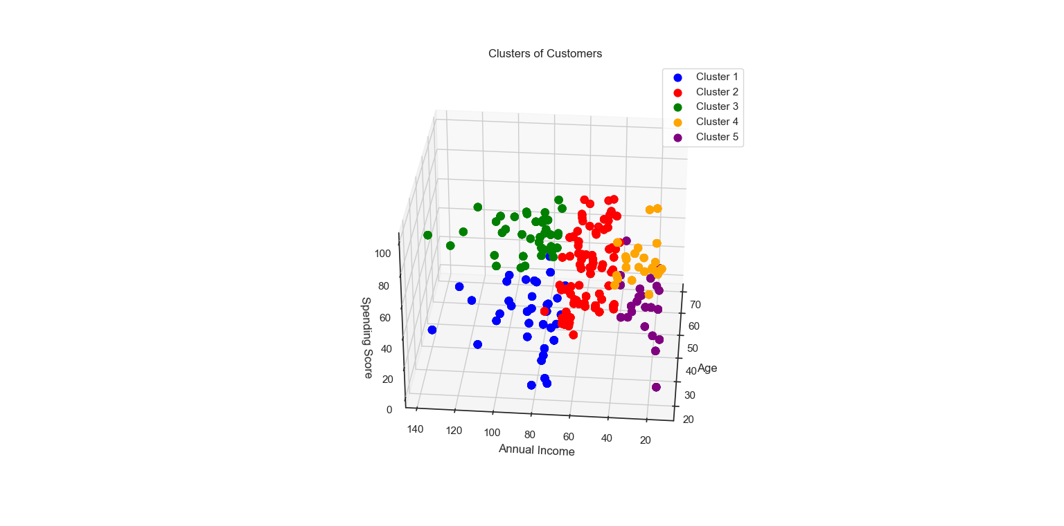
RESULTS:
28

Slide 29
CONCLUSIONS:
K means clustering is one of the most popular clustering algorithms and usually the first thing practitioners apply when solving clustering tasks to get an idea of the structure of the dataset.
The goal of K means is to group data points into distinct non-overlapping subgroups. One of the major application of K means clustering is segmentation of customers to get a better understanding of them which in turn could be used to increase the revenue of the company.
29

Slide 30
Useful Python Packages:
Pandas : Data analysis or data simulation package
Numpy: Scientific computational package
Seaborn: Statistical package
Matplotlib: Package to get various plots
32

Slide 31
Flow chart:
Start
Read CSV dataset
Perform K-Means clustering
Generate various plots based on useful columns available
End
Perform elbow method to find good fit value for K
33

Slide 32
Thank You
31

